Slide 1
session5: visualise data in R

Slide 2
Content
Visualising Data in R with ggplot2
General data visualisation tips

Slide 3
What can data visualisation do ?
help you to explore & understand your data
communicate your data

Slide 4
Visualising data in R with ggplot2
There are many ways to plot graphs in R
Base R has visualisation commands
ggplot2 package allows you to ‘layer’ features of graphs
works well with tidy data
it is part of the tidyverse, load it now with
library(ggplot2) or library(tidyverse)
(called ggplot2 because the first version had problems! confusingly the main command is still called just ggplot )

Slide 5
ggplot2 resources
ggplot is hugely popular (hundreds thousands of users)
lots of resources
but there is a bit of a learning curve
“It’s hard to succinctly describe how ggplot2 works because it embodies a deep philosophy of visualisation.”
most useful reference websitehttps://ggplot2.tidyverse.org/reference/index.html

Slide 6
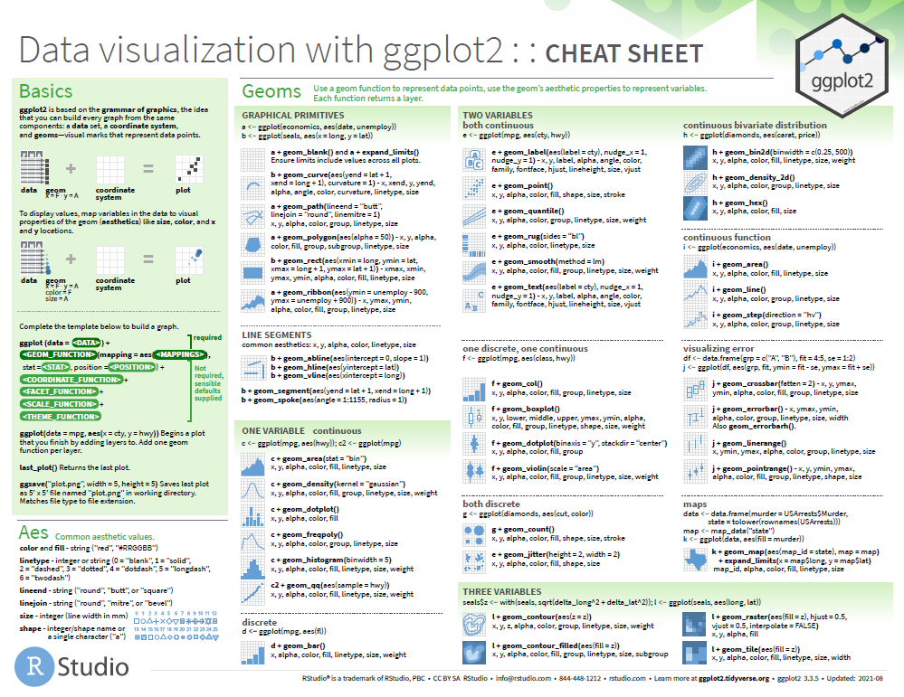
‘cheatsheet’ in folder of this course project

Slide 7
Structure of a ggplot command
takes a while to get used to the structure.
Different syntax possible
But in general:
ggplot(data = <DATA>) + <GEOM_FUNCTION>(mapping = aes(<MAPPINGS>))
I usually start by copying & pasting some existing code & modifying it.
Notes:
This will become more clear once we see examples

Slide 8
ggplot is very versatile
You can use the same structure for many types of graphs.
ggplot(data = date_frame_name) + style_of_plot(mapping = aes(x = column_name1, y = column_name2)) + other_arguments
Notes:
Explain a couple of things you can add on using the + sign.

Slide 9
What is a ‘geom’?
A geom is a visual aspect of a graph.
dots
lines
bars
Look at the ggplot2 cheatsheet for more options.

Slide 10
Live code dot plot with geom_point

Slide 11
Let’s create a line graph together
ggplot(data = cchic) + geom_smooth(mapping = aes(x = wbc, y = crp))
Notes:
Get them to type this code in and draw the graph. The graph they should get is on the next slide.

Slide 12
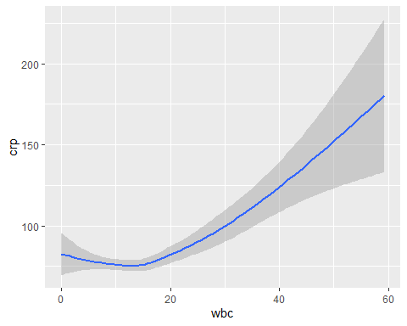

Slide 13
Adding a linetype
ggplot(data = cchic) + geom_smooth(mapping = aes(x = wbc, y = crp, linetype = sex))

Slide 14
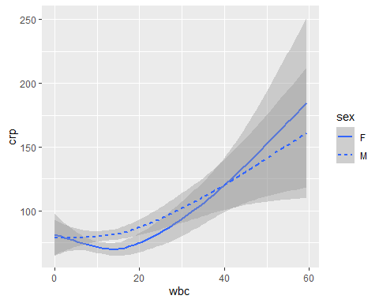

Slide 15
Adding colour
ggplot(data = cchic) + geom_smooth(mapping = aes(x = wbc, y = crp, colour = sex))

Slide 16
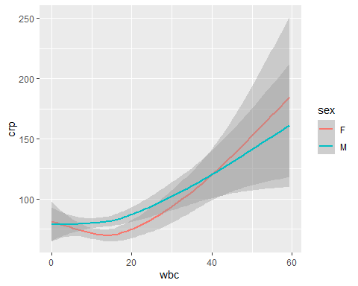

Slide 17
Combining multiple geoms
ggplot(data = cchic) + geom_point(mapping = aes(x = wbc, y = crp, colour = sex)) + geom_smooth(mapping = aes(x = wbc, y = crp))

Slide 18
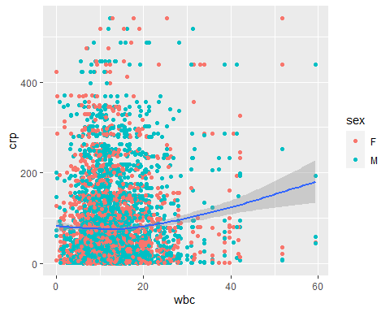

Slide 19
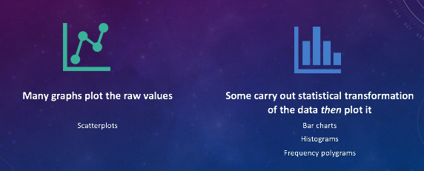
raw value plots vs summaries

Slide 20
Drawing a bar graph
geom_bar
ggplot(data = cchic) + geom_bar(mapping = aes(x = vital_status))

Slide 21
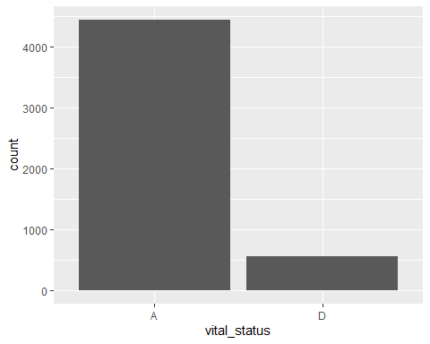

Slide 22
Proportion instead of count
ggplot(data = cchic) + geom_bar(mapping = aes(x = vital_status, y = ..prop.., group = 1))

Slide 23


Slide 24
Adding a second aesthetic
ggplot(data = cchic) + geom_bar(mapping = aes(x = vital_status, fill = sex))

Slide 25
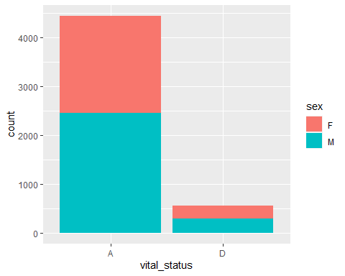

Slide 26
Standardising proportions
ggplot(data = cchic) + geom_bar(mapping = aes(x = vital_status, fill = sex), position = "fill")

Slide 27
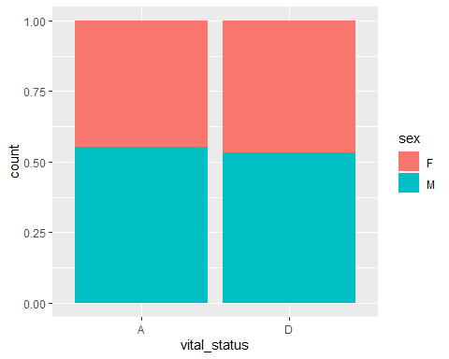

Slide 28
Changing position of bars
ggplot(data = cchic) + geom_bar(mapping = aes(x = vital_status, fill = sex), position = "fill")

Slide 30
Create your own plots now!

Slide 31
A few more general datavis guidelines to consider

Slide 32
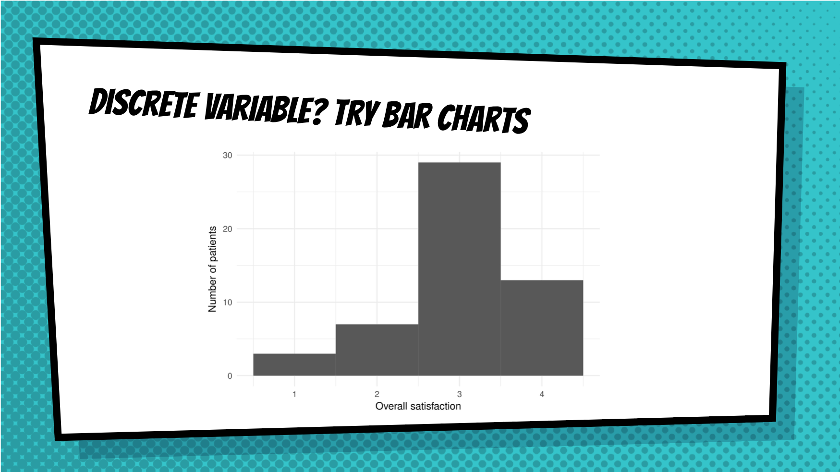

Slide 33
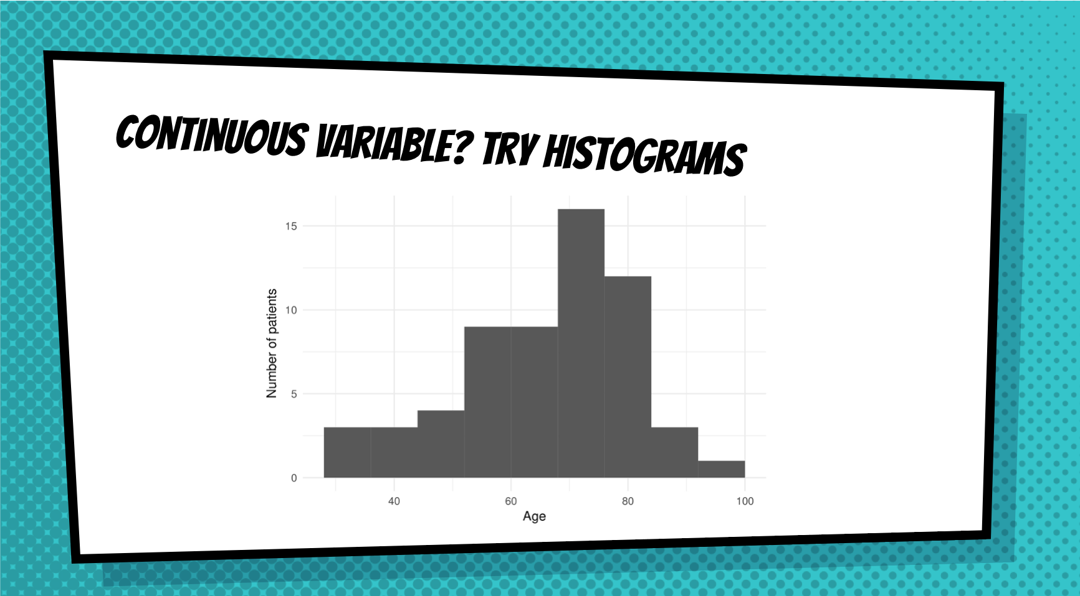

Slide 34
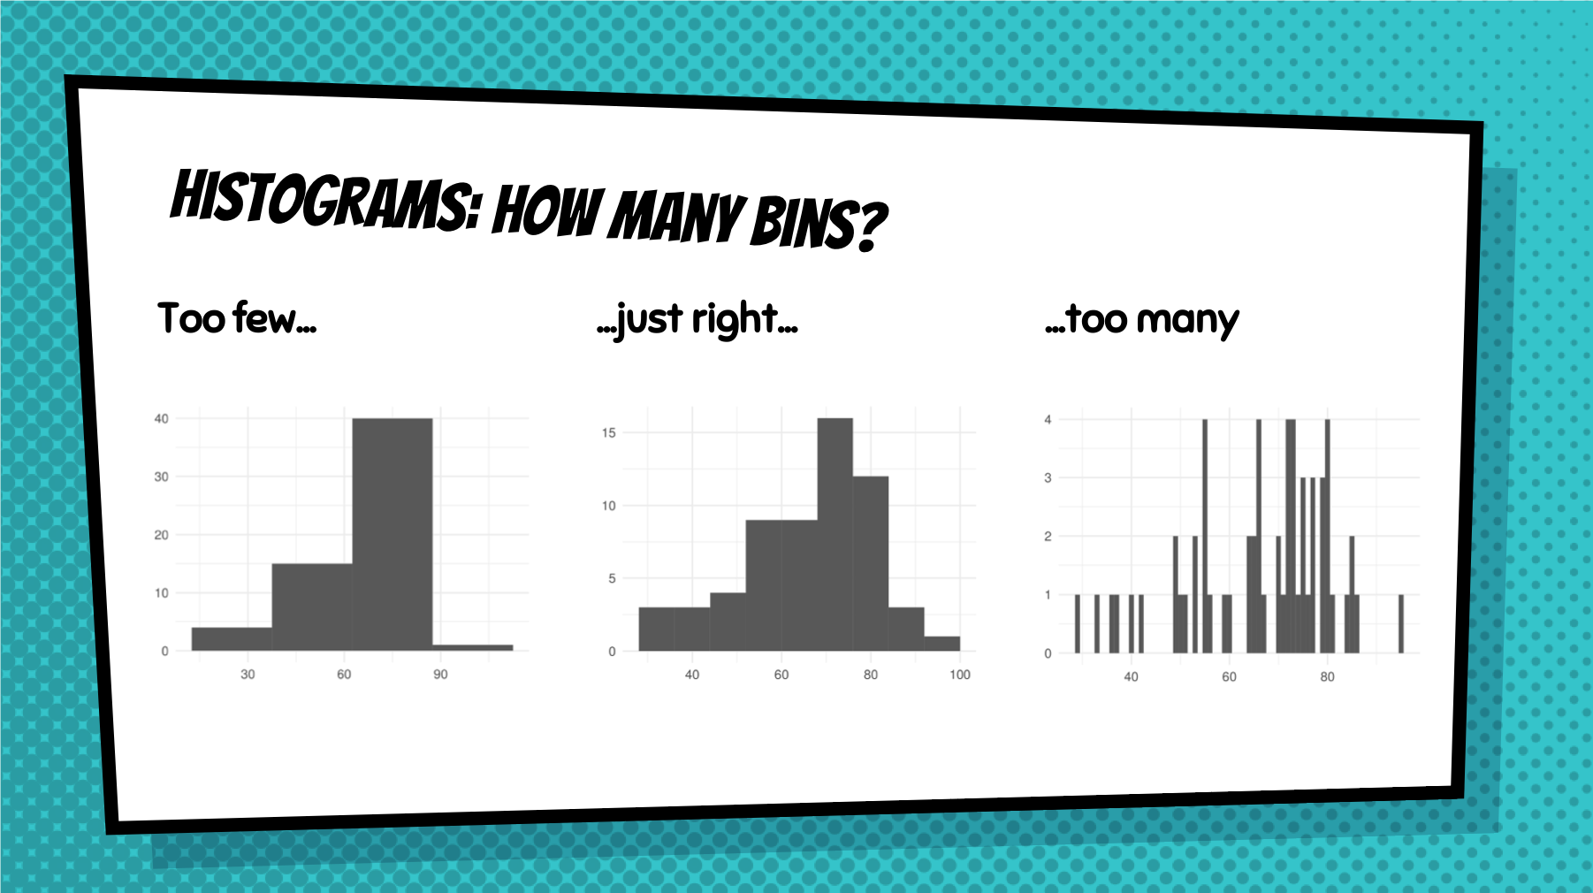

Slide 35
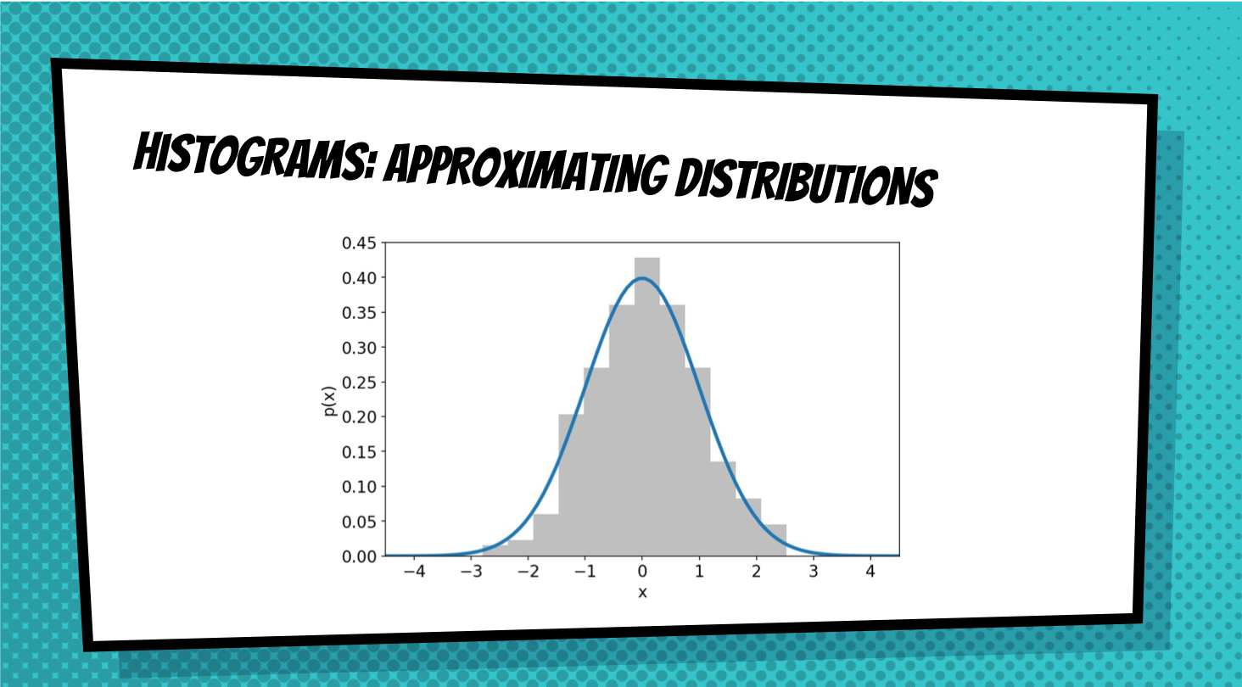

Slide 36
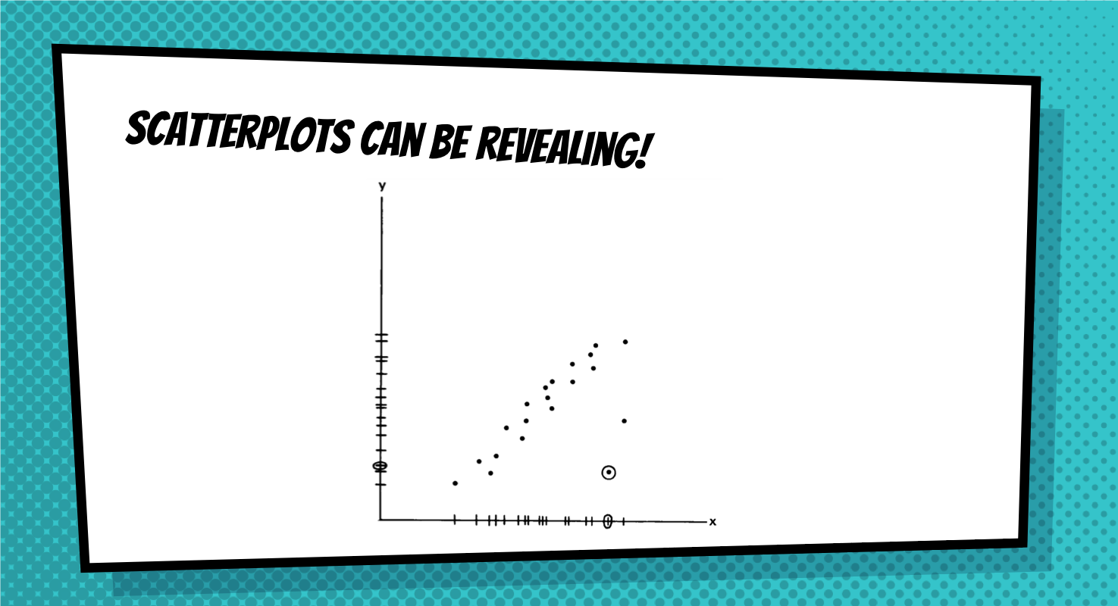

Slide 37


Slide 38
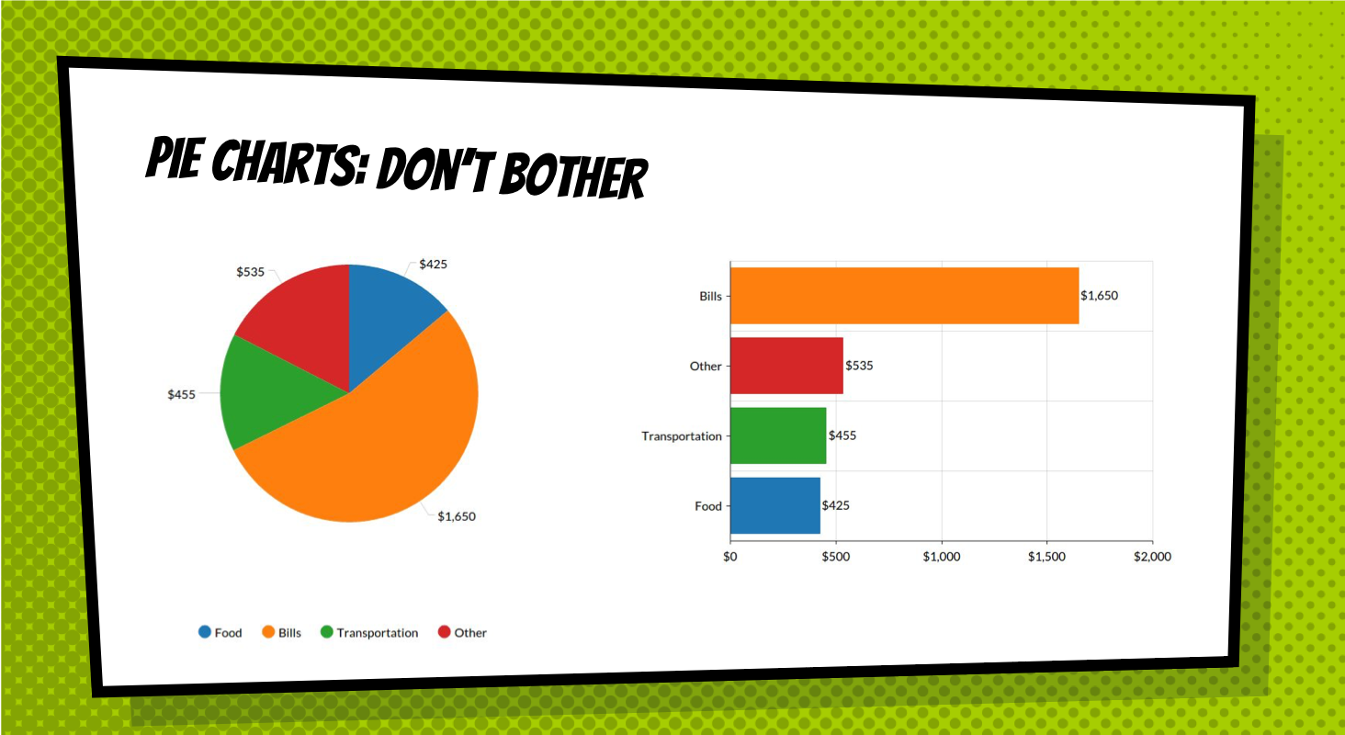

Slide 39
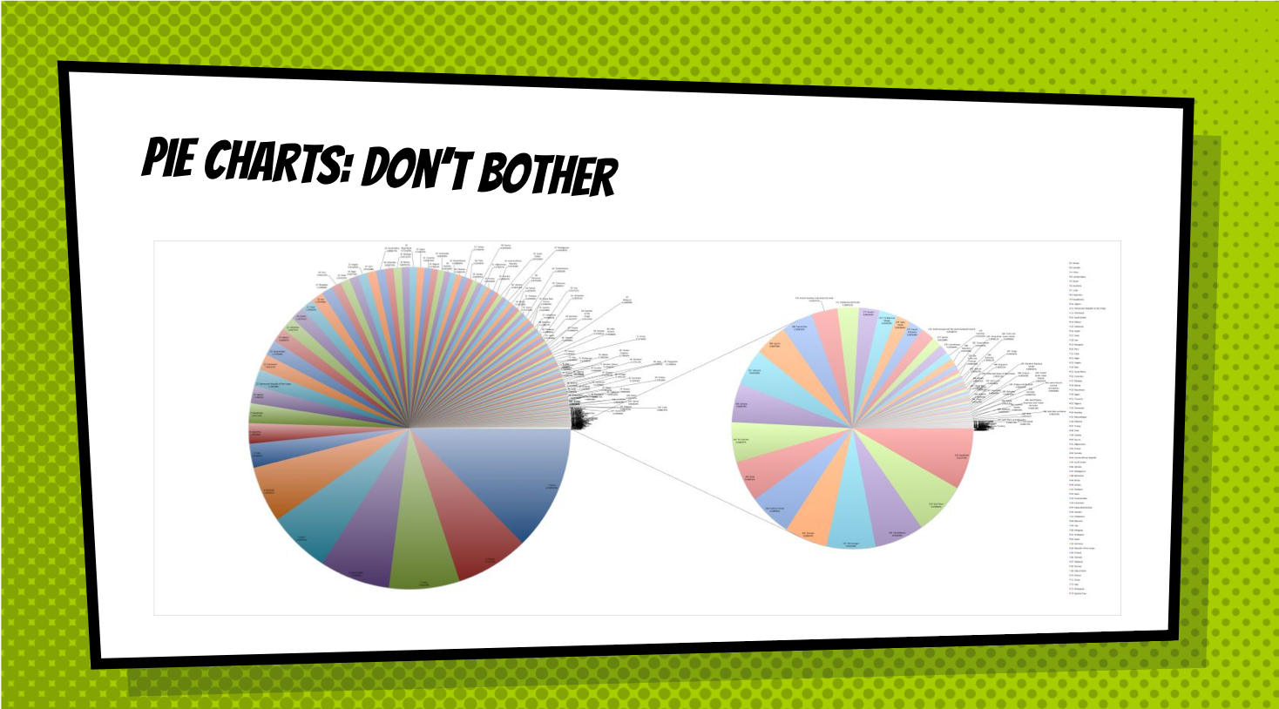

Slide 40
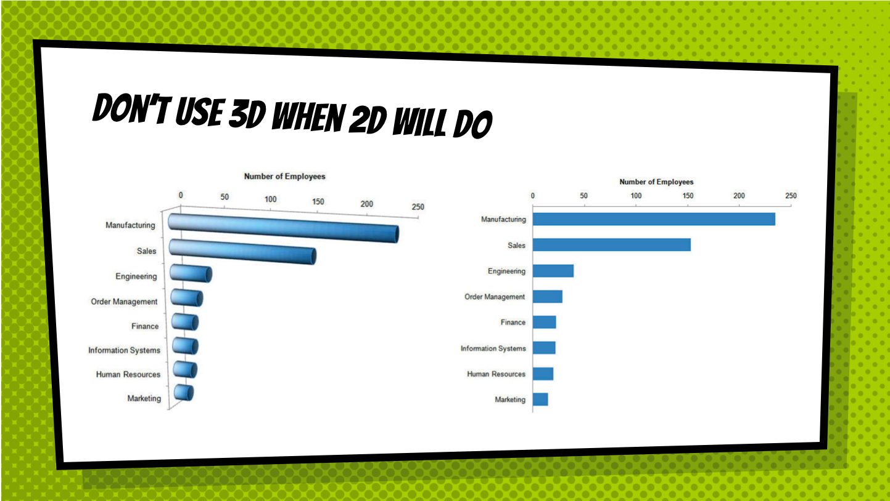

Slide 41
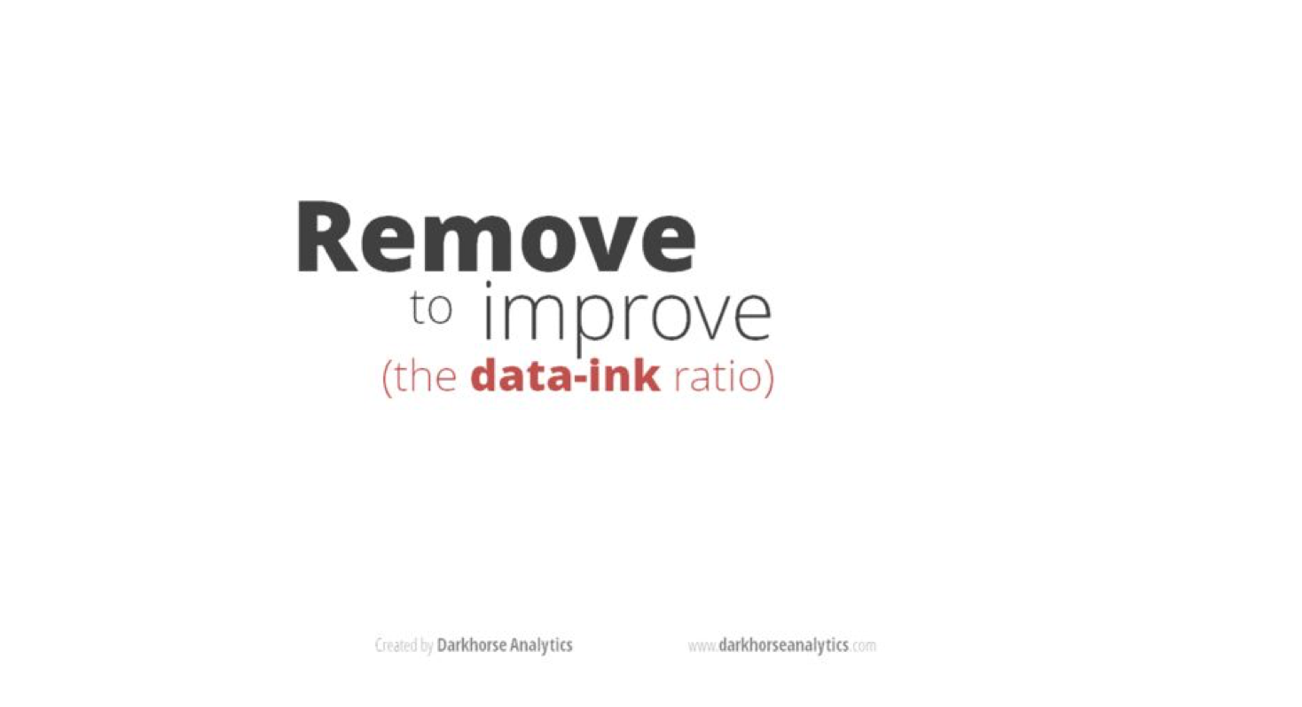

Slide 42


Slide 43
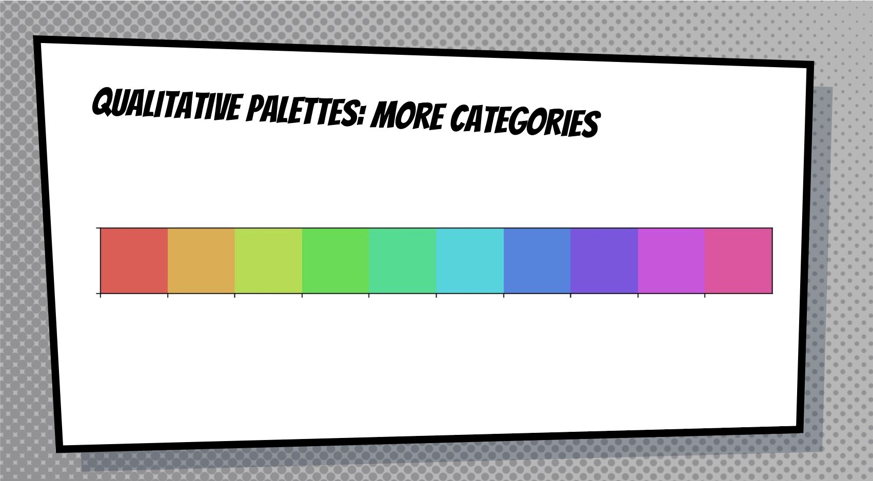

Slide 44
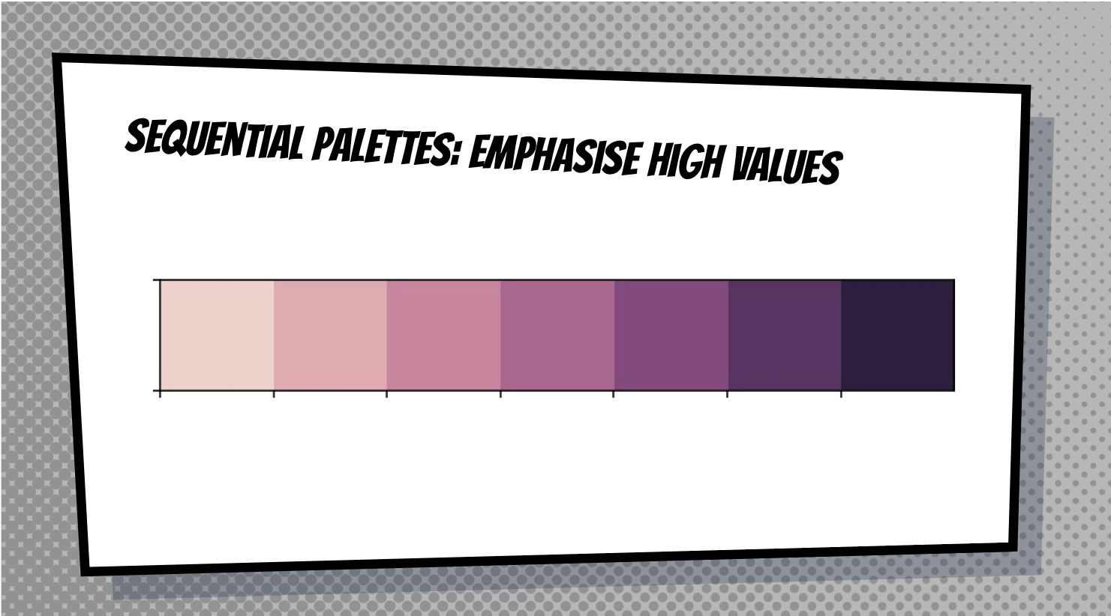

Slide 45
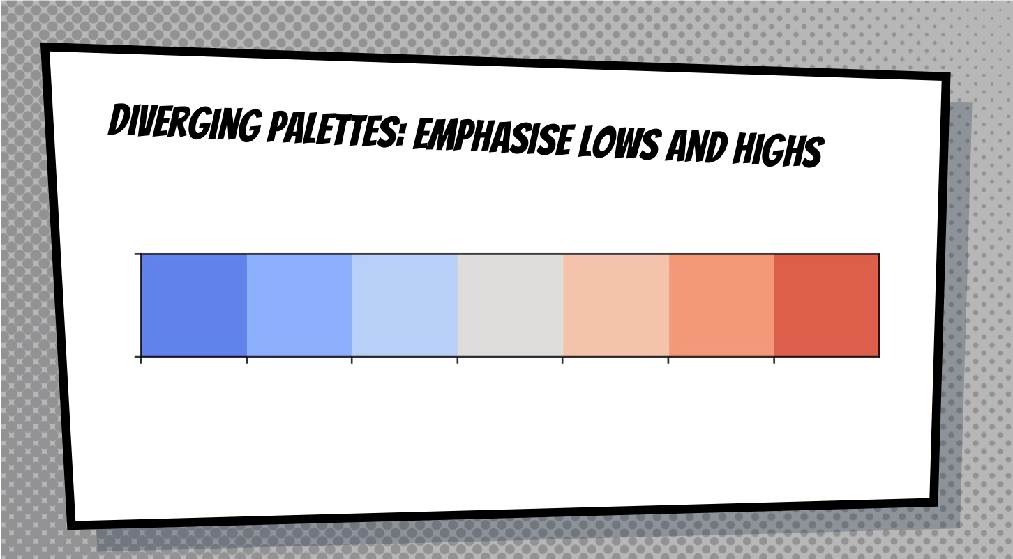

Slide 46
